Slide 1
Relative Motion Analysis (Vectors)
Dr. Agnes d’Entremont
Associate Professor of Teaching
Mechanical Engineering, University of British Columbia
(Original slides: Dr. Jacob Moore)

Slide 2
Planar Motion Analysis
When analyzing rigid body motion beyond fixed axis rotation. There are two general strategies, absolute motion analysis, and relative motion analysis.
In absolute motion analysis, a set of constraint equations is used to determine the position of a set point over time with respect to the ground, the velocity and acceleration of that point will be equal to the derivatives of the original equation.
In relative motion analysis, a series of equations describe the positions, velocities, and accelerations of several intermediate points leading from the ground to the point of interest. General equations are used to describe velocities and accelerations for each step, and the steps are all added together in the end.

Slide 3
Absolute vs. Relative Analysis
Absolute Motion Analysis:
Involves calculus
Faster and easier for simple problems
Relative Motion Analysis:
Does not involve calculus
Faster and easier for complex problems

Slide 4
Relative Motion Analysis
In relative motion analysis we identify the velocities and accelerations by breaking down motion into steps and adding those motions together
What separates relative motion analysis from absolute motion analysis is that we use pre-determined equations for velocity and acceleration, rather than taking derivatives
These equations are based on a translating rectangular coordinate system.
We will wind up with the same equations we had in absolute motion analysis, but we will not be taking derivatives to find these equations.

Slide 5
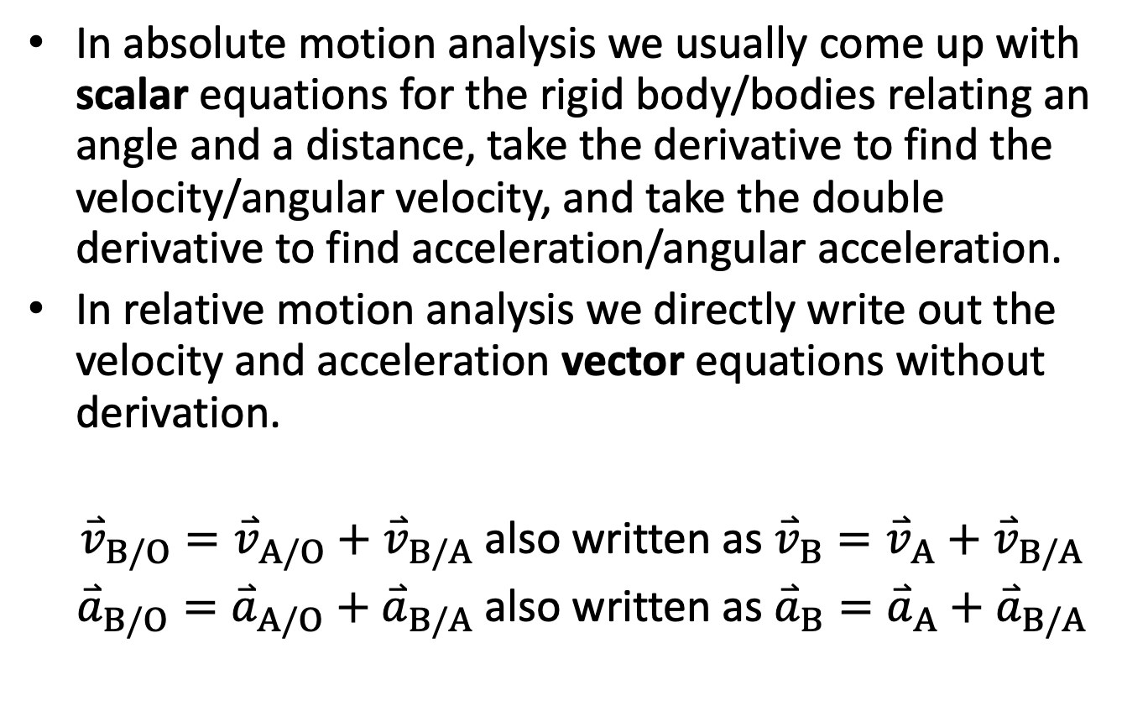
Relative Motion Analysis
In absolute motion analysis we usually come up with scalar equations for the rigid body/bodies relating an angle and a distance, take the derivative to find the velocity/angular velocity, and take the double derivative to find acceleration/angular acceleration.
In relative motion analysis we directly write out the velocity and acceleration vector equations without derivation.
${\overset{⃑}{v}}_{B/O}={\overset{⃑}{v}}_{A/O}+{\overset{⃑}{v}}_{B/A}$ also written as ${\overset{⃑}{v}}_{B}={\overset{⃑}{v}}_{A}+{\overset{⃑}{v}}_{B/A}$
${\overset{⃑}{a}}_{B/O}={\overset{⃑}{a}}_{A/O}+{\overset{⃑}{a}}_{B/A}$ also written as ${\overset{⃑}{a}}_{B}={\overset{⃑}{a}}_{A}+{\overset{⃑}{a}}_{B/A}$

Slide 6








Multiple Coordinate Systems
In relative motion analysis, each separate rigid body will have its own coordinate system, and there is a fixed coordinate system (not moving).
With bodies that are pinned together, we use coordinate systems that translate but not rotate with the body
(See Rotating Frames for cases when the coordinate system also rotates with the body)
$$y_{2}$$
C
$$ϕ$$
$$x_{2}$$
B
$$y_{1}$$
$$Y$$
$$θ$$
$$x_{1}$$
$$X$$
O
A

Slide 7

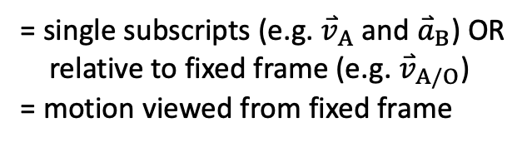


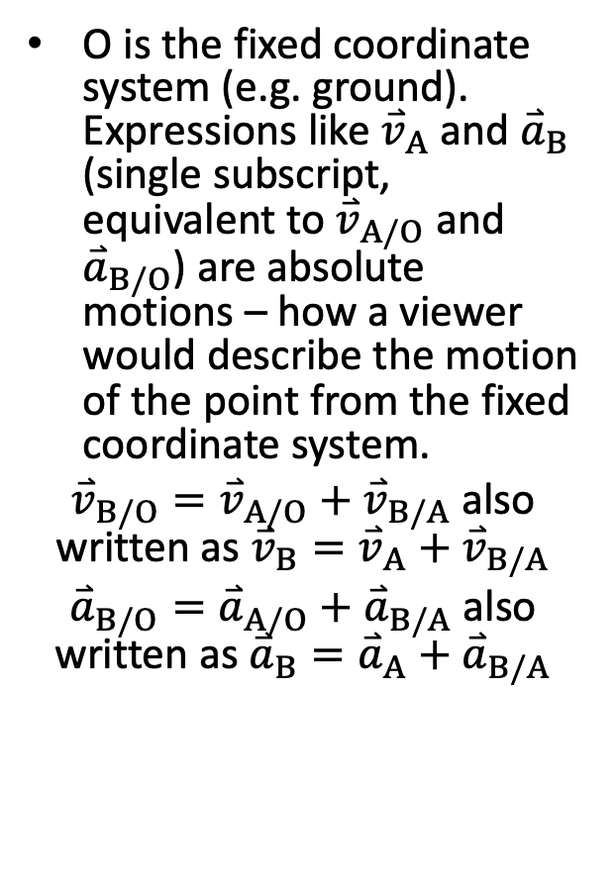


Meaning of Relative Motion Equations
O is the fixed coordinate system (e.g. ground). Expressions like ${\overset{⃑}{v}}_{A}$ and ${\overset{⃑}{a}}_{B}$ (single subscript, equivalent to ${\overset{⃑}{v}}_{A/O}$ and ${\overset{⃑}{a}}_{B/O}$) are absolute motions – how a viewer would describe the motion of the point from the fixed coordinate system.
${\overset{⃑}{v}}_{B/O}={\overset{⃑}{v}}_{A/O}+{\overset{⃑}{v}}_{B/A}$ also written as ${\overset{⃑}{v}}_{B}={\overset{⃑}{v}}_{A}+{\overset{⃑}{v}}_{B/A}$
${\overset{⃑}{a}}_{B/O}={\overset{⃑}{a}}_{A/O}+{\overset{⃑}{a}}_{B/A}$ also written as ${\overset{⃑}{a}}_{B}={\overset{⃑}{a}}_{A}+{\overset{⃑}{a}}_{B/A}$
$${\overset{⃑}{v}}_{B}$$
B
$${\overset{⃑}{v}}_{A}$$
A
$$Y$$
= single subscripts (e.g. ${\overset{⃑}{v}}_{A}$ and ${\overset{⃑}{a}}_{B}$) OR
relative to fixed frame (e.g. ${\overset{⃑}{v}}_{A/O}$)
= motion viewed from fixed frame
$$X$$
O
CC BY binocular by iconcheese from the Noun Project

Slide 8


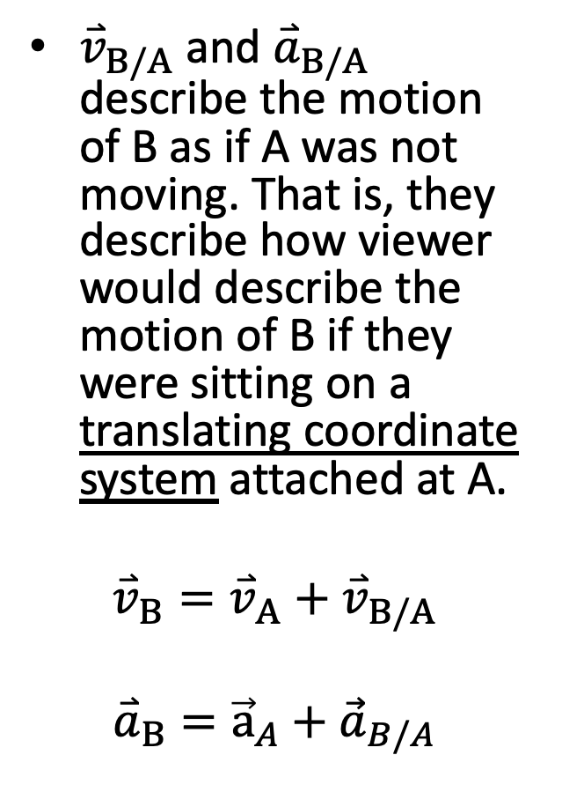






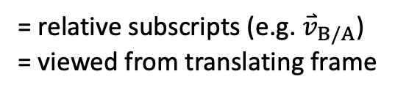
Meaning of Relative Motion Equations
${\overset{⃑}{v}}_{B/A}$ and ${\overset{⃑}{a}}_{B/A}$ describe the motion of B as if A was not moving. That is, they describe how viewer would describe the motion of B if they were sitting on a translating coordinate system attached at A.
$${\overset{⃑}{v}}_{B}={\overset{⃑}{v}}_{A}+{\overset{⃑}{v}}_{B/A}$$
$${\overset{⃑}{a}}_{B}={\vec{a}}_{A}+{\vec{a}}_{B/A}$$
$${\overset{⃑}{v}}_{B/A}$$
$$\vec{ω}$$
$$y_{1}$$
$$y_{1}$$
B
$$y_{1}$$
$$x_{1}$$
$$x_{1}$$
$$x_{1}$$
A
= relative subscripts (e.g. ${\overset{⃑}{v}}_{B/A}$)
= viewed from translating frame
$$Y$$
$$X$$
O
CC BY binocular by iconcheese from the Noun Project

Slide 9
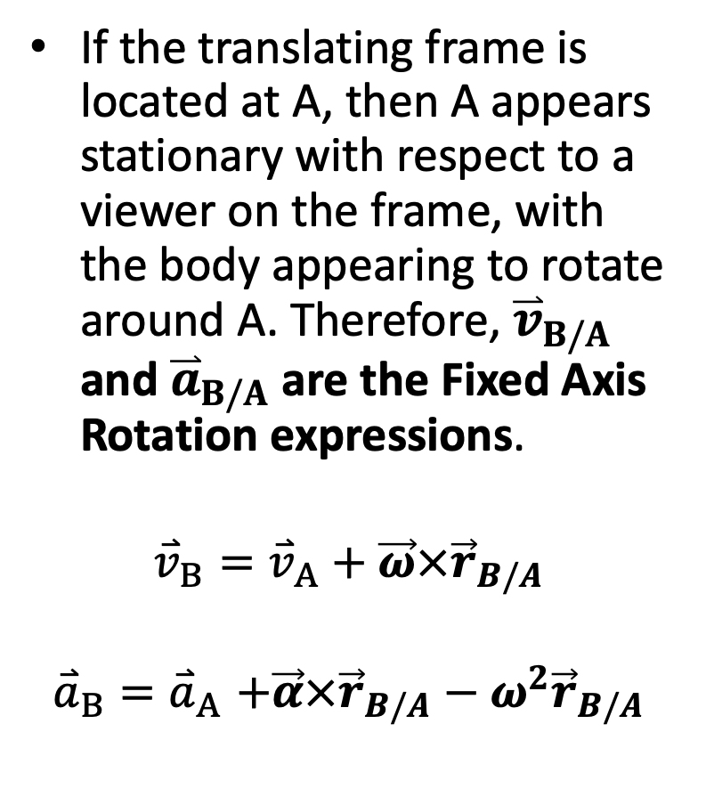

Meaning of Relative Motion Equations
If the translating frame is located at A, then A appears stationary with respect to a viewer on the frame, with the body appearing to rotate around A. Therefore, ${\overset{⃑}{v}}_{B/A}$ and ${\overset{⃑}{a}}_{B/A}$ are the Fixed Axis Rotation expressions.
$${\overset{⃑}{v}}_{B}={\overset{⃑}{v}}_{A}+\vec{ω}×{\vec{r}}_{B/A}$$
$${\overset{⃑}{a}}_{B}{=\overset{⃑}{a}}_{A}+\vec{α}×{\vec{r}}_{B/A}−ω^{2}{\vec{r}}_{B/A}$$
$${\overset{⃑}{v}}_{B/A}$$
B
$$y_{1}$$
$$x_{1}$$
A
CC BY binocular by iconcheese from the Noun Project

Slide 10

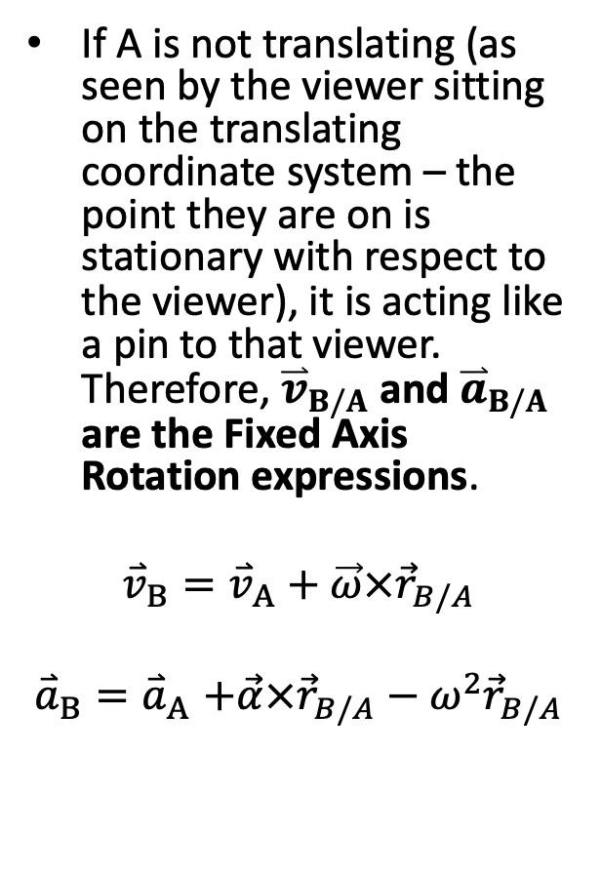

Meaning of Relative Motion Equations
If A is not translating (as seen by the viewer sitting on the translating coordinate system – the point they are on is stationary with respect to the viewer), it is acting like a pin to that viewer. Therefore, ${\overset{⃑}{v}}_{B/A}$ and ${\overset{⃑}{a}}_{B/A}$ are the Fixed Axis Rotation expressions.
$${\overset{⃑}{v}}_{B}={\overset{⃑}{v}}_{A}+\vec{ω}×{\vec{r}}_{B/A}$$
$${\overset{⃑}{a}}_{B}{=\overset{⃑}{a}}_{A}+\vec{α}×{\vec{r}}_{B/A}−ω^{2}{\vec{r}}_{B/A}$$
$${\overset{⃑}{v}}_{B}$$
$${\overset{⃑}{v}}_{B/A}$$
$$\vec{ω}$$
$$y_{1}$$
B
$${\overset{⃑}{v}}_{A}$$
$$x_{1}$$
A
$$Y$$
$$X$$
O
CC BY binocular by iconcheese from the Noun Project

Slide 11
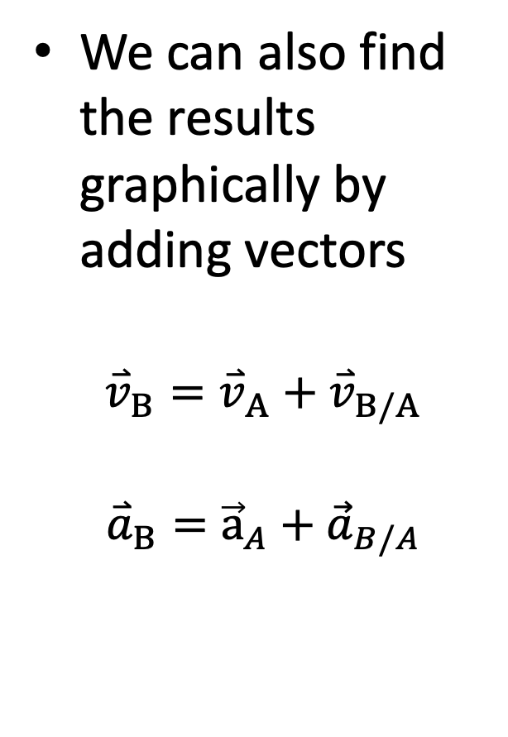


Meaning of Relative Motion Equations
We can also find the results graphically by adding vectors
$${\overset{⃑}{v}}_{B}={\overset{⃑}{v}}_{A}+{\overset{⃑}{v}}_{B/A}$$
$${\overset{⃑}{a}}_{B}={\vec{a}}_{A}+{\vec{a}}_{B/A}$$
$${\overset{⃑}{v}}_{B}$$
$${\overset{⃑}{v}}_{A}$$
$${\overset{⃑}{v}}_{B/A}$$
$$\vec{ω}$$
$$y_{1}$$
B
$${\overset{⃑}{v}}_{A}$$
$$x_{1}$$
A
$$Y$$
$$X$$
O
CC BY binocular by iconcheese from the Noun Project

Slide 12
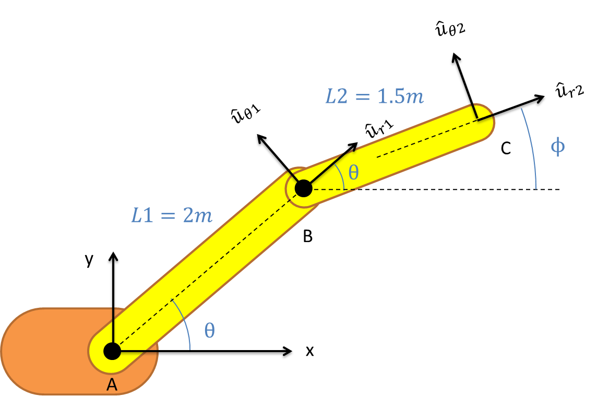
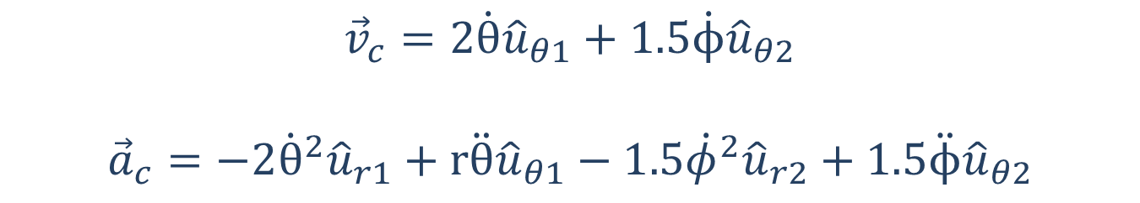
Relative Motion Analysis
$${\vec{v}}_{c}=2\dot{θ}{\hat{u}}_{θ1}+1.5\dot{ϕ}{\hat{u}}_{θ2}$$
$${\vec{a}}_{c}=−2{\dot{θ}}^{2}{\hat{u}}_{r1}+r\ddot{θ}{\hat{u}}_{θ1}−1.5{\dot{φ}}^{2}{\hat{u}}_{r2}+1.5\ddot{ϕ}{\hat{u}}_{θ2}$$

Slide 13




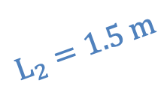


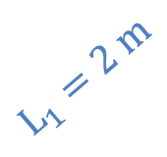
Relative Motion Analysis
$\vec{ω_{BC}}$, $\vec{α_{BC}}$
$$y_{2}$$
C
$$L_{2}=1.5 m$$
$\vec{ω_{AB}}$, $\vec{α_{AB}}$
$$ϕ$$
$$x_{2}$$
B
$$y_{1}$$
$$L_{1}=2 m$$
$$Y$$
$$θ$$
$$x_{1}$$
$$X$$
O
A
$${\vec{v}}_{C}={\vec{v}}_{A}+{\vec{ω}}_{AB}×{\vec{r}}_{B/A}+{\vec{ω}}_{BC}×{\vec{r}}_{C/B}$$
$${\vec{a}}_{C}={\vec{a}}_{A}+{\vec{α}}_{AB}×{\vec{r}}_{B/A}−ω_{AB}^{2}{\vec{r}}_{B/A}+{\vec{α}}_{BC}×{\vec{r}}_{C/B}−ω_{BC}^{2}{\vec{r}}_{C/B}$$

Slide 14
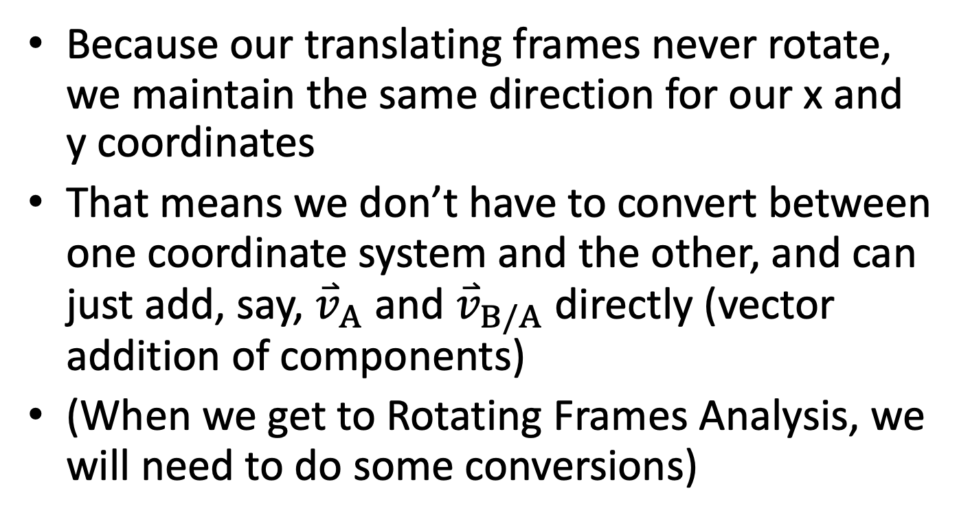
Dealing with Multiple Coordinate Systems
Because our translating frames never rotate, we maintain the same direction for our x and y coordinates
That means we don’t have to convert between one coordinate system and the other, and can just add, say, ${\overset{⃑}{v}}_{A}$ and ${\overset{⃑}{v}}_{B/A}$ directly (vector addition of components)
(When we get to Rotating Frames Analysis, we will need to do some conversions)

Slide 15
Relative Motion Analysis Process
Start by creating a diagram of the body, with the key distances and angles labeled
Be sure to add a fixed coordinate system (x and y directions)
Identify any known angular and linear velocities and accelerations (magnitude and/or direction)
Define unknown vectors
Start stepping through from a point with known velocity/ acceleration toward the point you want to know about
Use a series of relative motion equations as needed, substituting into one equation
Use the equations you have generated, along with any current angles, distances, velocities, and accelerations to solve for the unknowns
Create two scalar equations (x and y directions) from your vector equation to solve for up to two unknowns

Slide 16
Thanks for Watching
See other engineering mechanics videos and access the full tool at…

Slide 17
Worked Example
The robotic arm shown below has a fixed orange base at A and fixed length members AB and BC. Motors at A and B allow for rotational motion at the joints. Based on the angular velocities and accelerations shown at each joint, determine the velocity and the acceleration of the end effector at C.
y
A
3 ft
B
x
30º
5 rad/s
3 rad/s
-2 rad/s²
.2 rad/s²
2 ft
C

Slide 18
y
A
3 ft
B
x
30º
5 rad/s
3 rad/s
-2 rad/s²
.2 rad/s²
2 ft
C

Slide 19


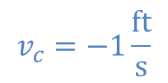
Worked Example
The robotic arm from the previous problem is in the configuration shown below. Assume that theta is currently 30 degrees and that point C currently lies along the x axis. If we want the end effector at C to travel 1 ft/s in the negative x direction, what should the angular velocities be at joints A and B?
y
B
3 ft
2 ft
$$ϕ$$
$$θ$$
x
$$v_{c}=−1\frac{ft}{s}$$
A
C

Slide 20
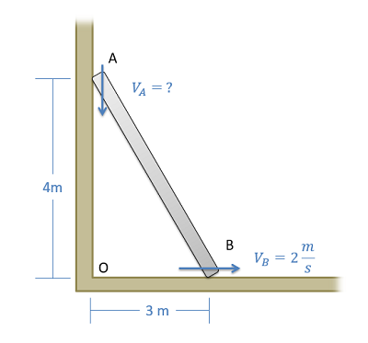
Worked Example
A ladder is propped up against a wall as shown below. If the base of the ladder is sliding out at a speed of 2 m/s, what is the speed of the top of the ladder?

Slide 21
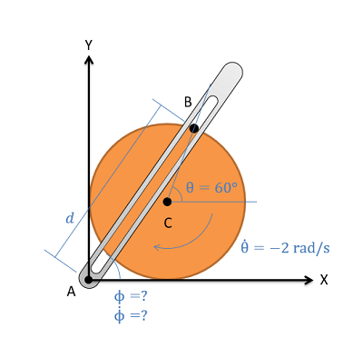
Worked Example
The crank-rocker mechanism as shown below consists of a crank with a radius of .5 meters rotating about its fixed center at C at a constant rate of 2 rad/s clockwise. Rocker AB fixed at it's base at A and connects to point B along the edge of the crank. The pin at point B can slide along a frictionless slot in AB. In the current state, what is the angular velocity of rocker AB?

